Slide 1

StraySpotter
Asa Dillahunty, Dylan Marcum-Pollard,
Lillian Presley, Sav Campbell

Slide 2
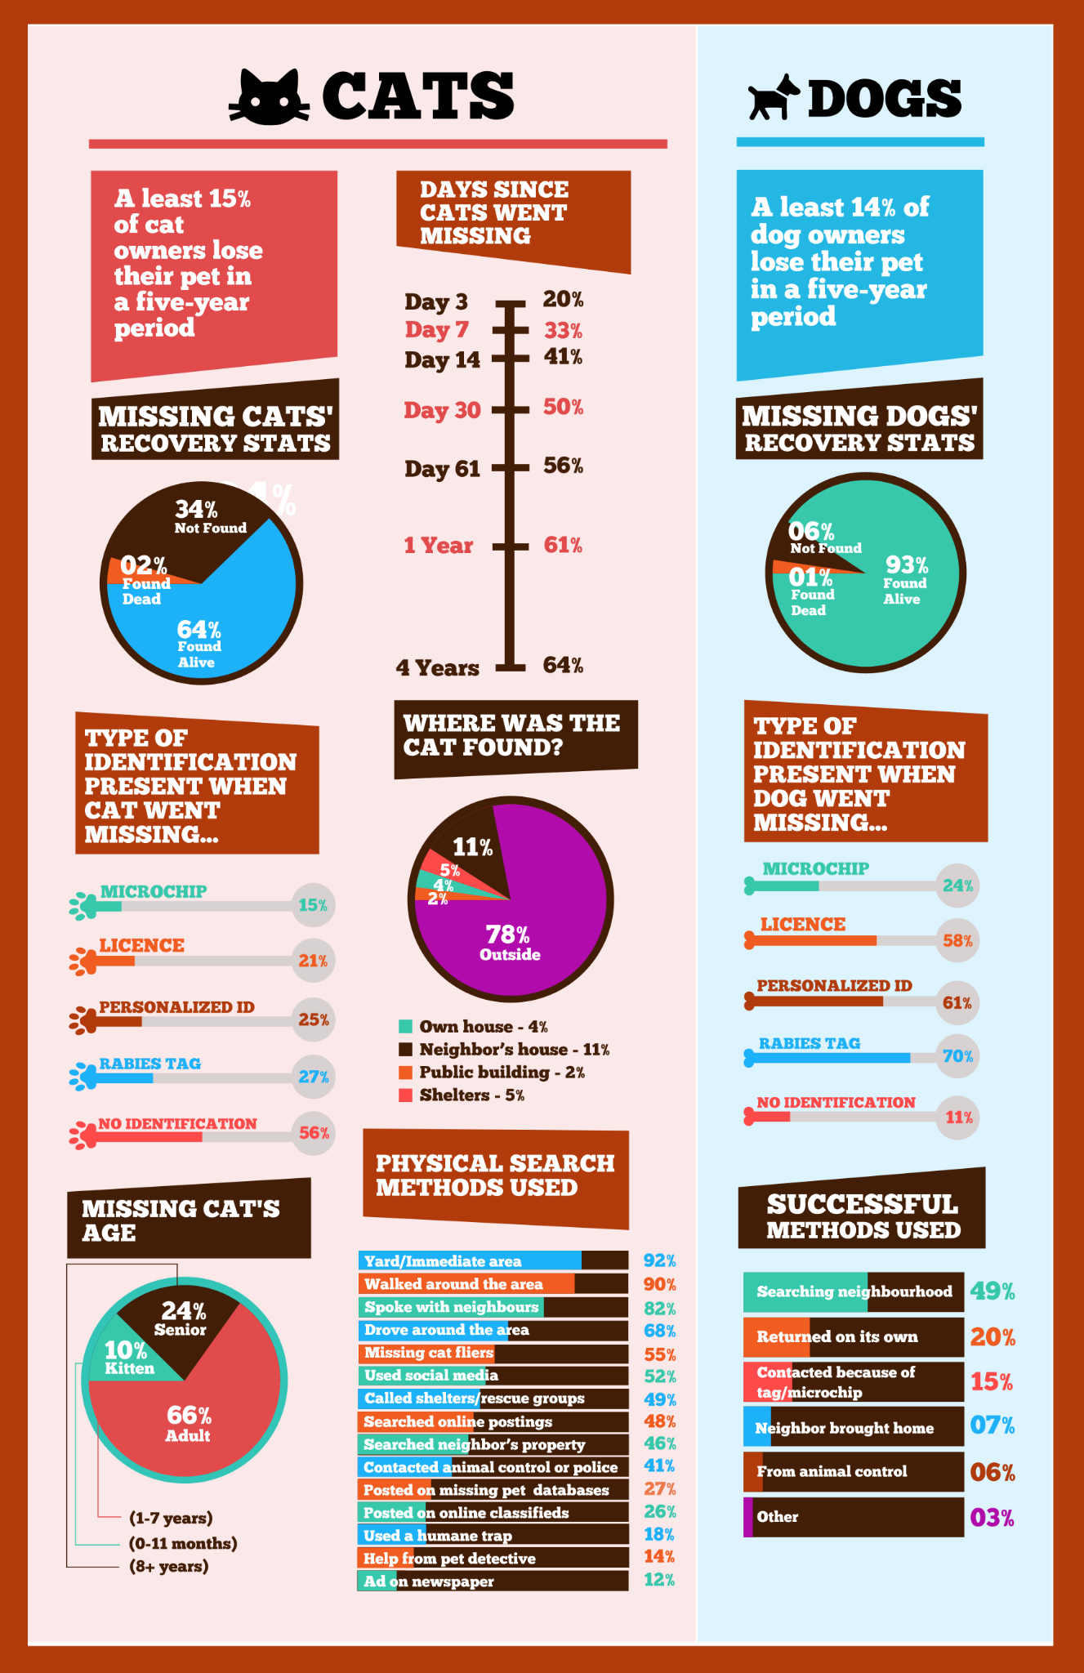
Nobody wants to lose a pet
Studies say that anywhere between fifteen to thirty-three percent of people lose their pets at some point in the pet’s lifetime.
Only 64% of missing pets are found alive.
Roughly ten million dogs and cats go missing every year.
Estimates differ but the ASPCA estimates 7.6 million dogs and cats go to shelters while the Humane Society estimates 4.3 million.
However, surveys put that estimate as high as 9.5 to 9.6 million
Anywhere from 35% to 64% of those are euthanized.

Slide 3
Who does this serve?
This app primarily is meant to assist pet owners who lost their pet (specifically, dogs and cats).
This apps intended user base, however, also includes runners and frequent walkers as well as animal lovers and those who often stumble across stray animals.
Additionally, it could be useful for animal shelters so that they can see where stray animals are more prevalent and sighted.
It can also be useful for animal control to know where strays are located so that they can catch them and hopefully find their owners or take them to the animal shelter so they can (hopefully) find forever homes.

Slide 4
Core Features
Mobile app for IOS and Android
Allows users to upload pictures and description of stray or lost pets
Geotags the location where it was spotted
Allows owners to look through posts for lost pets and see where they were last spotted

Slide 5
Potential Features
Matching pictures of animals (tabby cats with tabby cats, dogs with dogs)
Getting data from local shelters on what animals are currently there
Website
Claim a pet if it has been found

Slide 6



Technical details
Website
HTML5
CSS3
Javascript
GitHub Pages
Mobile App
React Native
Expo Go
Backend
Firebase
Authentication
Firestore
Realtime Database

Slide 7
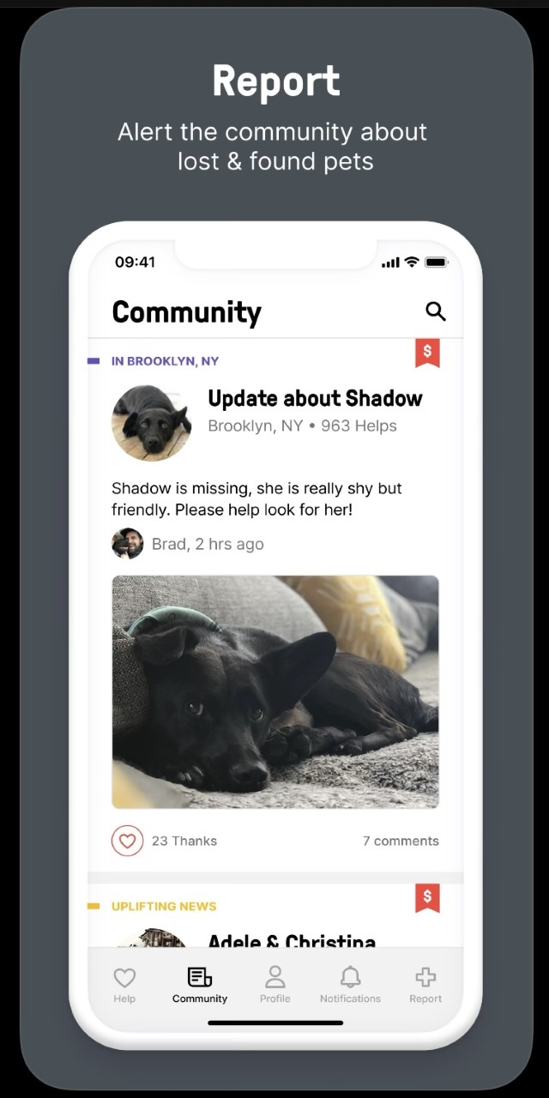
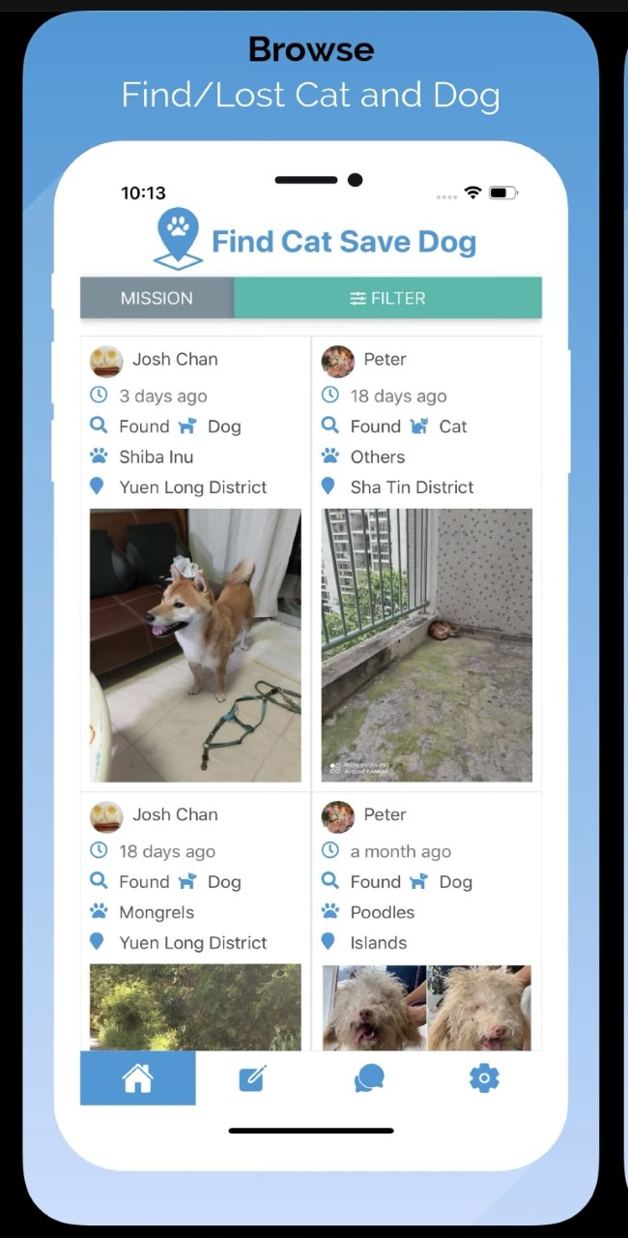
Related Apps and Competitors
Save a Stray
Connects users to local animal shelters
Does not require users to post the animal on the app
Requires users to be able to bring stray animals to a shelter or vet clinic
Shadow
Established user base and media presence
Social media and community reliant
Does not work as well outside of large cities due to the social media-style posts

Slide 8
Possible Challenges and Obstacles
The app will only be as useful as its user base is large.
We are potentially splitting the userbases of larger, more established apps
There could be a lot of initial labor if we choose to connect the app with local animal shelters depending on how we choose to do that.
Similar animals may be photo matched incorrectly
Server space may become an issue with a large user base

Slide 9
Bibliography
https://lostpetresearch.com/2019/03/lost-pet-statistics/
https://www.aspca.org/about-us/press-releases/how-many-pets-are-lost-how-many-find-their-way-home-aspca-survey-has-answers
https://www.americanhumane.org/fact-sheet/animal-shelter-euthanasia-2/
https://shadowapp.com/
http://saveastrayapp.com/

